Slide 1
Teamcenter 14
Kaur Jaakma
22.8.2022

Slide 2
Content
How to change password
How to create Items and Parts
How to Search
How to create Sequences
How to create Revisions

Slide 3

Siemens Teamcenter (TC)
Product Data/Lifetime Management system
Current version 14, released 2022
Integrated with NX (CAD/CAM/CAE software)

Slide 4
Teamcenter UI
Rich Client
Installed on Aalto computers where also NX
No home installation possibility
Active Workspace
Browser-based UI
http://teamcenter.aalto.fi:3000/
Available for home use (if NX installed using script from download.aalto.fi)

Slide 5
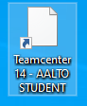
Login at Aalto
Students who answered to Starting Survey got access to TC
Rich Client can be started from Aalto computer
Teamcenter 14 – AALTO STUDENT
Active Workspace (browser version) can be accessed thru VPN
From http://teamcenter.aalto.fi:3000/

Slide 6
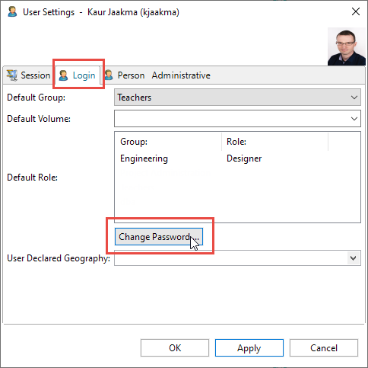
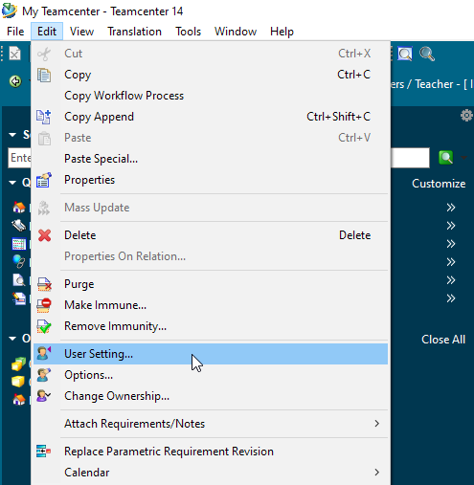
Changing Password
Rich Client

Slide 7
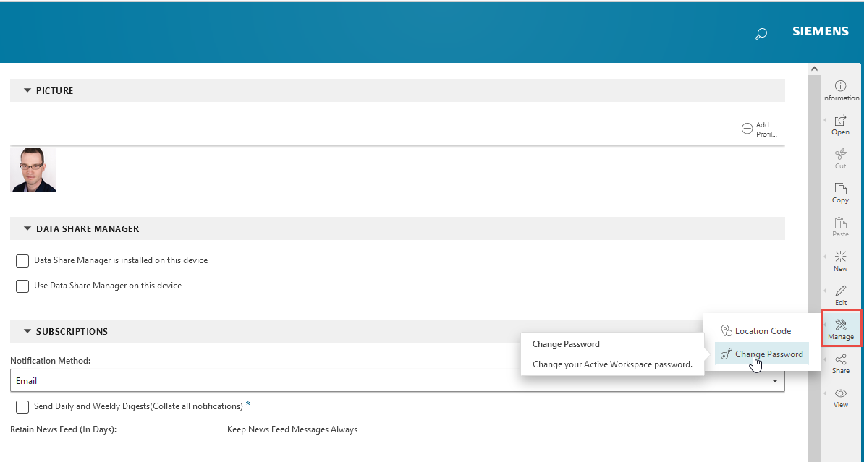
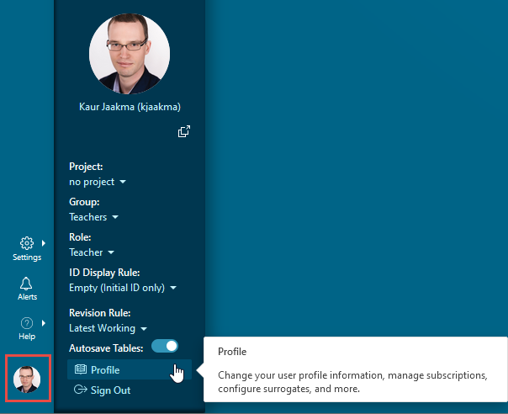
Changing Password
Active Workspace

Slide 8
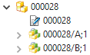
Terminology
Item
Revision (A)
Revision (B)
Item
General item in the database
“Folder” to hold item related information
Revision
A version of an item, item has always at least one revision
Created by Revise process
Sequence
A version of a revision; Created with Check Out/Check In process
Sequence (1)

Slide 9
Rich Client

Slide 10
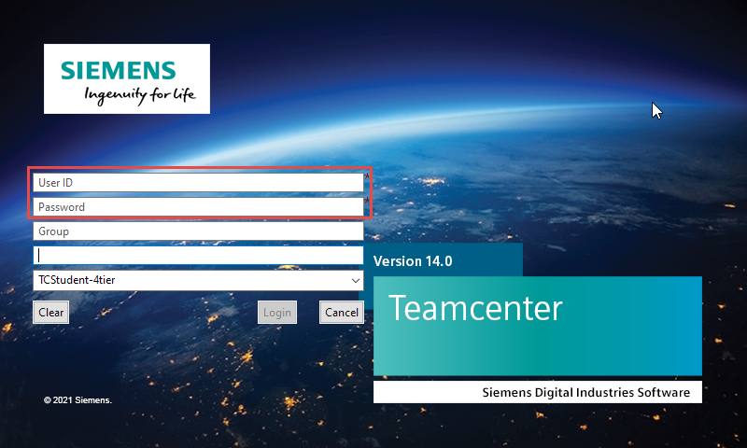
Login

Slide 11
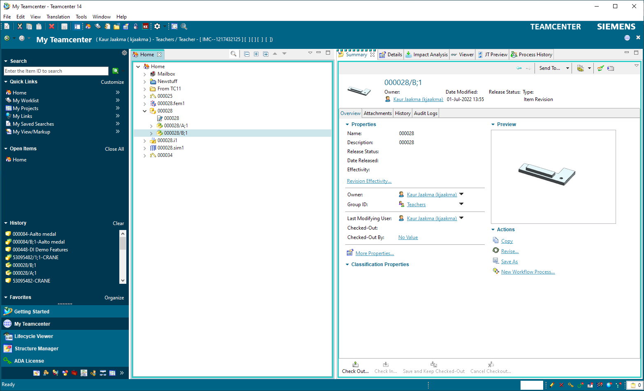
User Interface
Search
Quick links
Home folder
Different modes
Active item

Slide 12
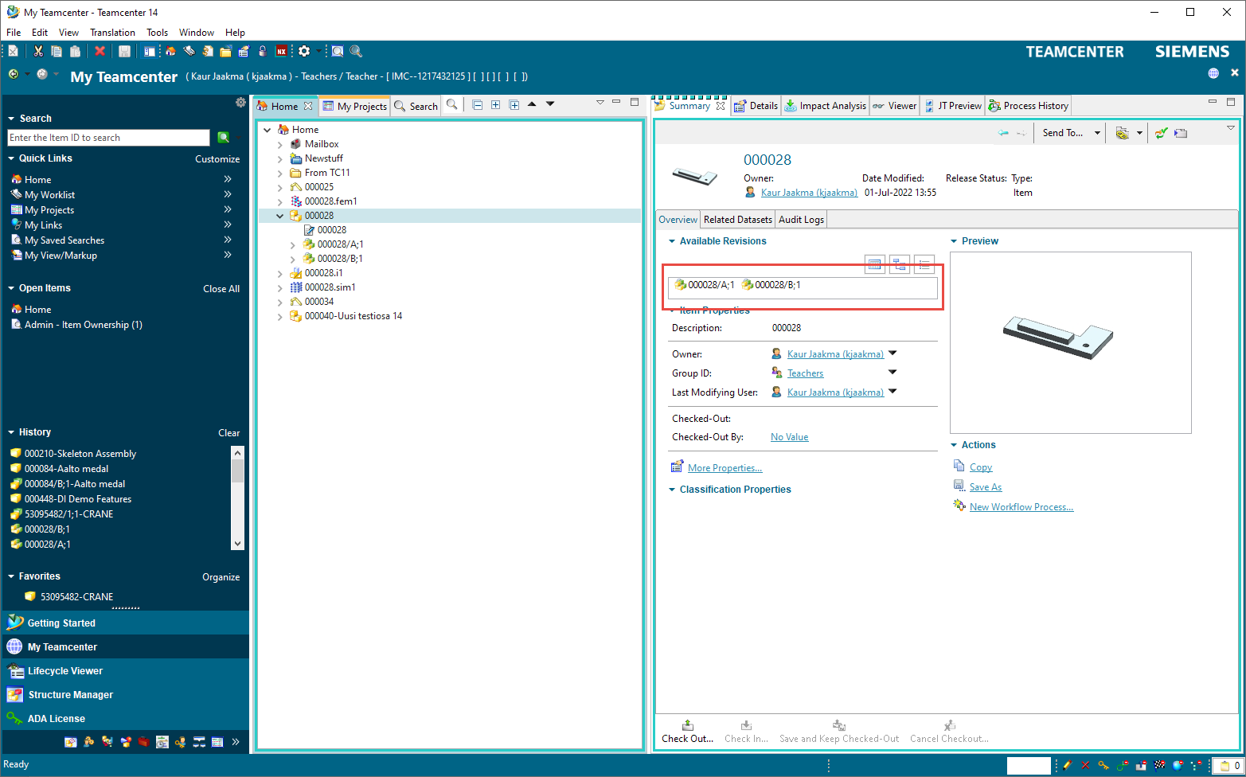
Active Item
When an Item is selected, Summary view is created
Here you can see all revisions the item has
In this case:
000028/A;1
000028/B:1

Slide 13
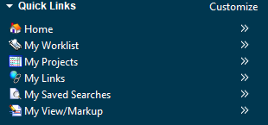
Quick Links
Home and My Projects can be found here
Home contains items that are created by you but not assigned to any project
Project shows items belonging to different projects

Slide 14
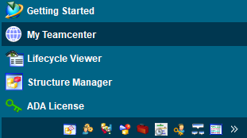
Different modes
Different modes allow different toolsets
Mostly My Teamcenter is enough
If something is not allowed, it may be mode issue
Change back to My Teamcenter

Slide 15
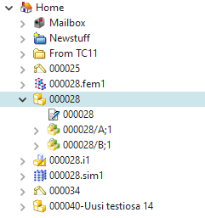
Home Folder
Items created/imported by you are stored by default here
If no different location given while creating the item/part

Slide 16
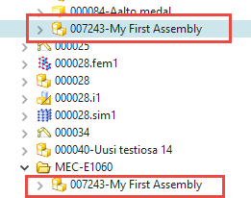
Home Folder
Home folder is a visibility folder, where you can see selected models
Usually, the ones you have created
The same model can be there several times
The actual files are stored at database

Slide 17
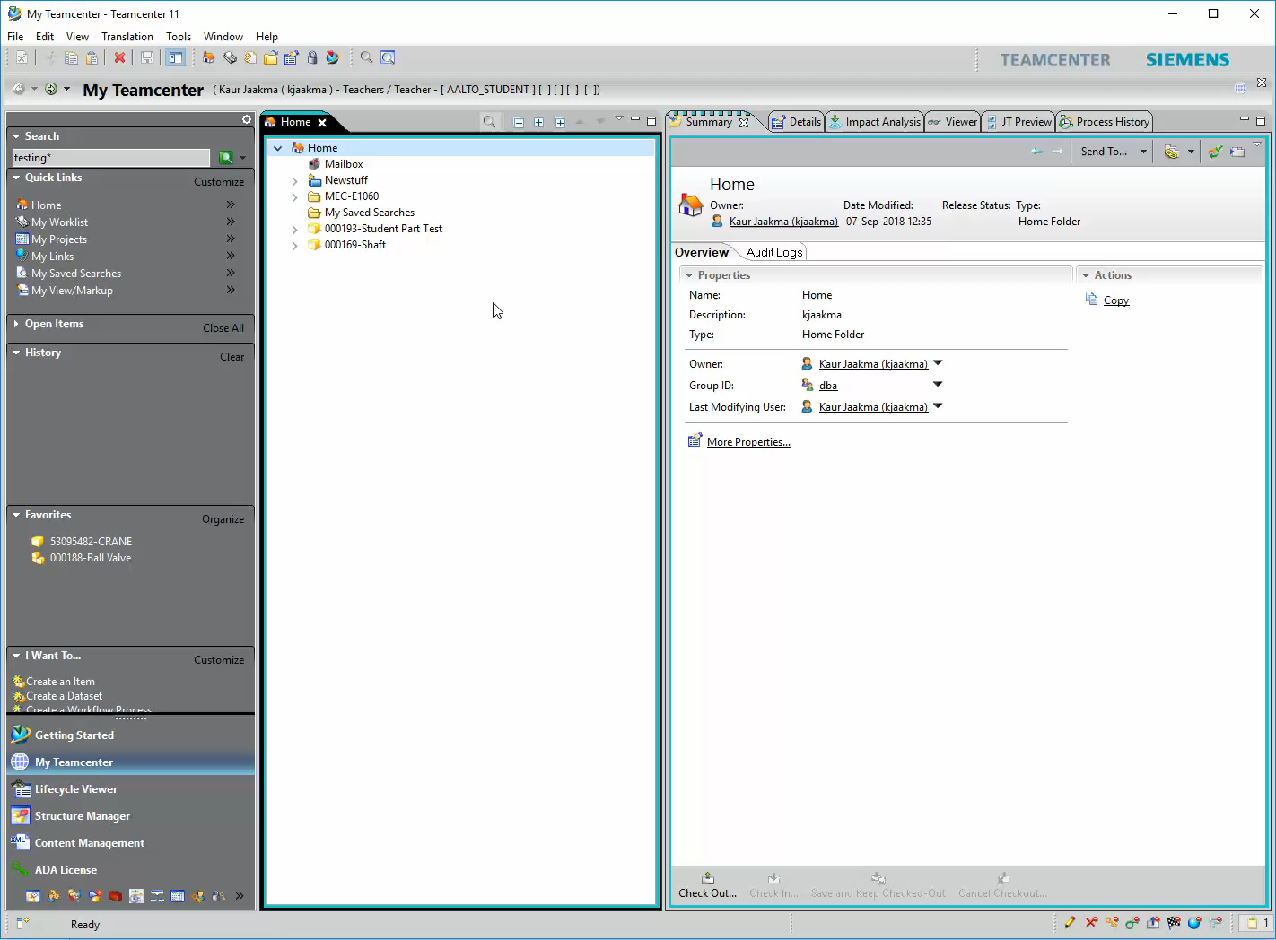
Adding Items to Your Home Folder
Copy+Paste can be used
Search item you want to add
Ctrl+C
Go to your home folder
Ctrl+V
Remove files from Home directory
Ctrl+X (cut)
Note! This does not delete the file from the Teamcenter!

Slide 18
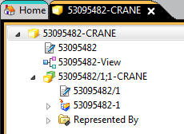
Item Structure (Assembly)
Item (Part)
ID number–Name
BOM file
Part Revision
ID/Revision;Sequence-Name
In this case main assembly
Can have several revisions
Geometry
In this case NX model

Slide 19
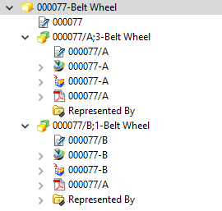
Item Structure (Part)
Item (Part)
ID number–Name
Part Revision (A, B, C, …)
Older revision
Current revision
Geometry
NX file
Other files
PDF

Slide 20
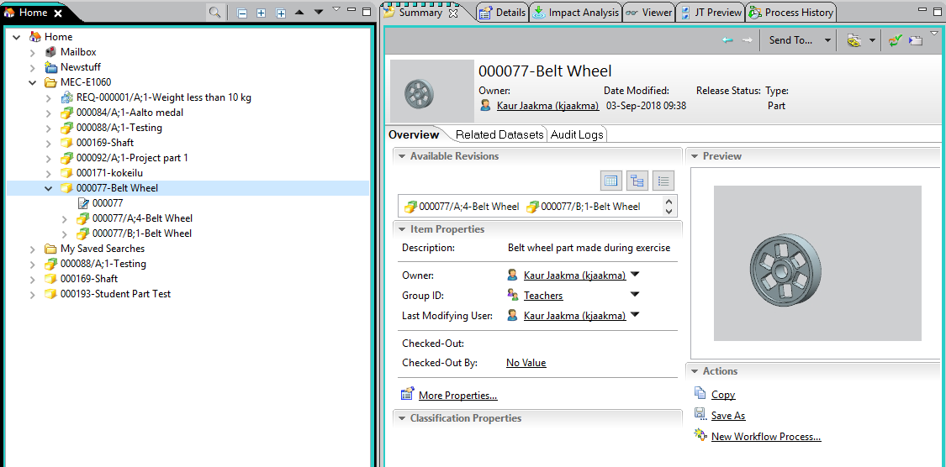
Item Structure (Part)
When opening Item (Part), the newest revision and sequence will be opened
In this case B;1
Older sequences are automatically hidden
Only A;4 visible

Slide 21
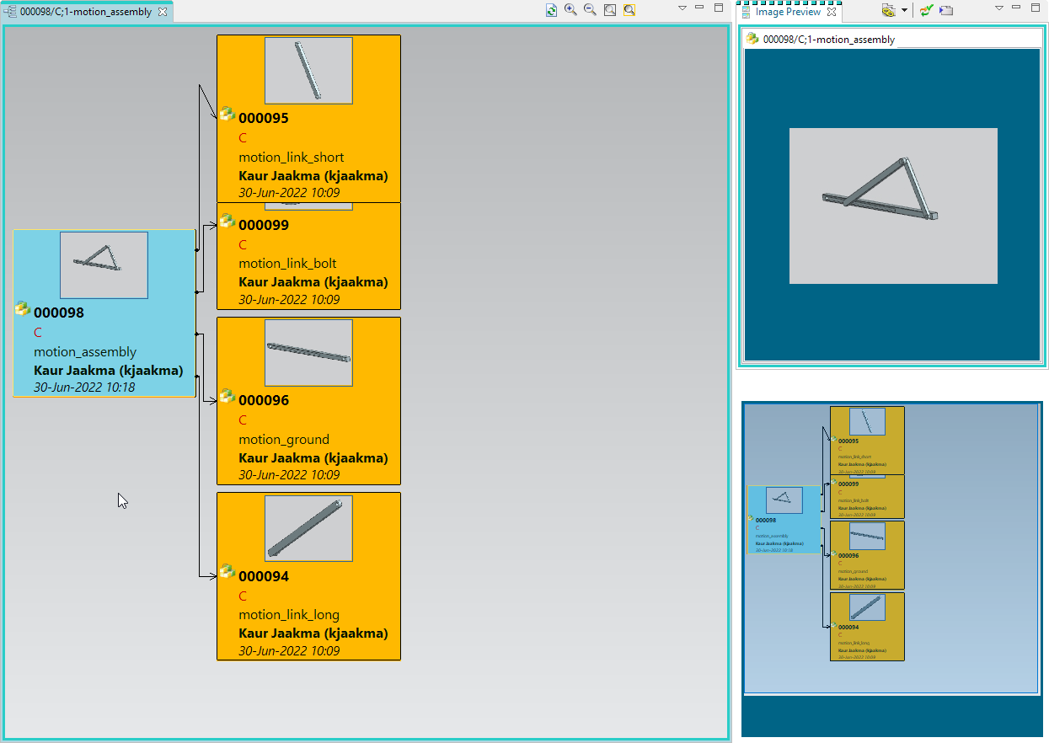
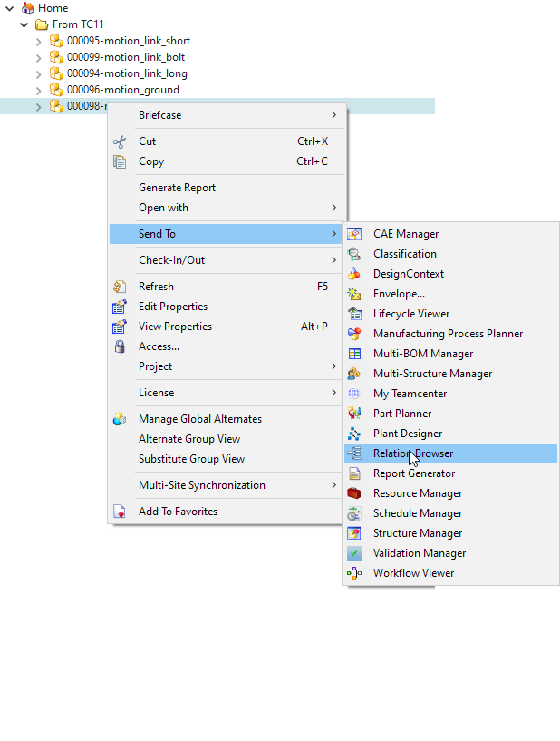
Relation Browser

Slide 22
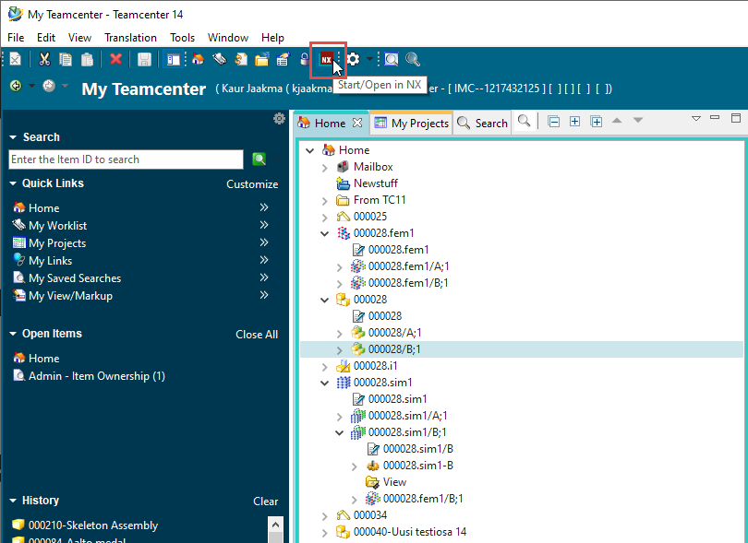
Start/Open in NX
Can be found from upper row
Opens NX and pairs it with current Teamcenter session
Also available in File → Open in NX

Slide 23
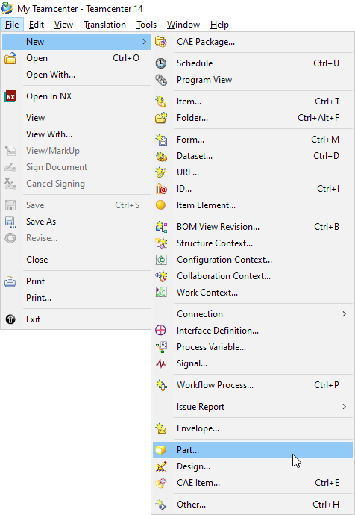
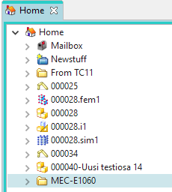
New Part
Select where you want new item (part) to appear
In this case in a folder in Home
Then File→New→Part…

Slide 24
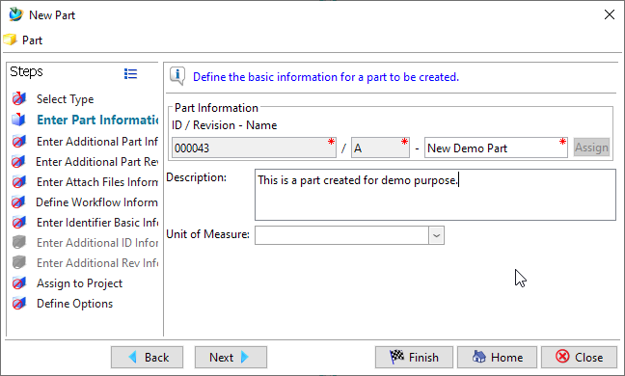
New Part
Select part type (Part) and Next
Click Assign to assign ID and Revision for the part
Give a Name for your part
Additionally description
Finish to create part
Close to close New Part tool

Slide 25
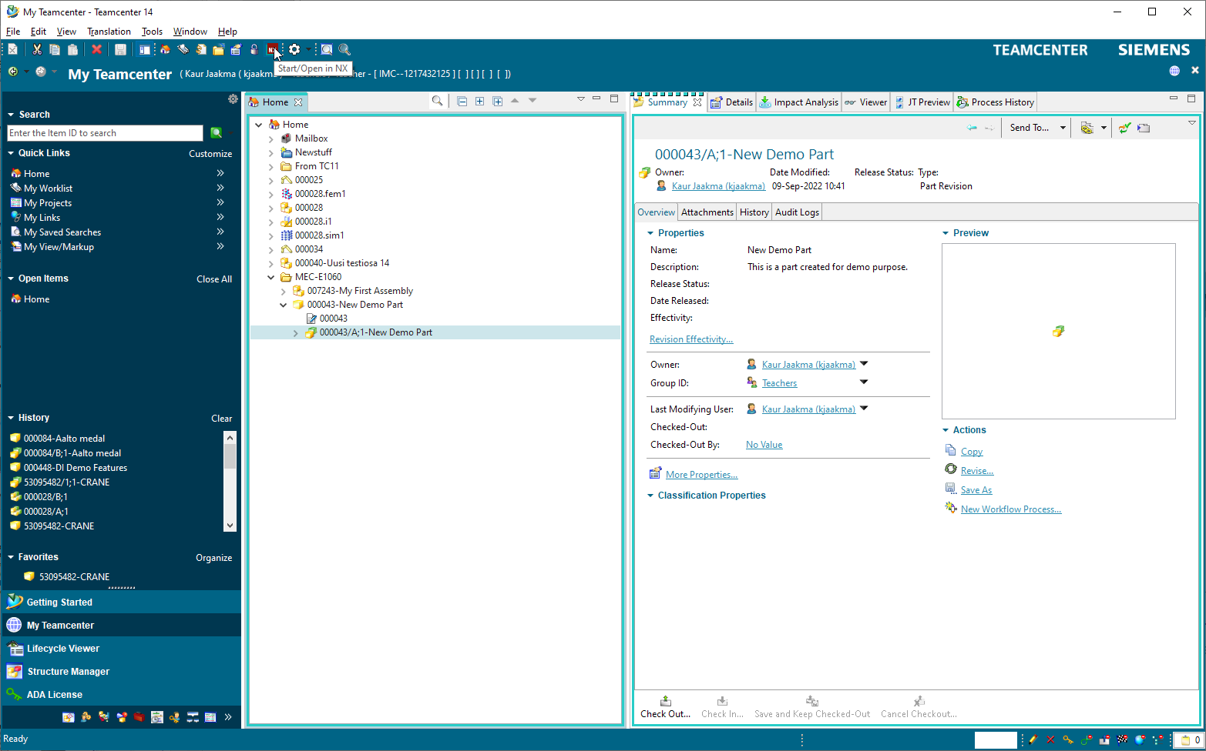
New Part
The new created part and its first revision will be shown in Teamcenter
To create CAD geometry, select Revision and Open in NX from the menu

Slide 26
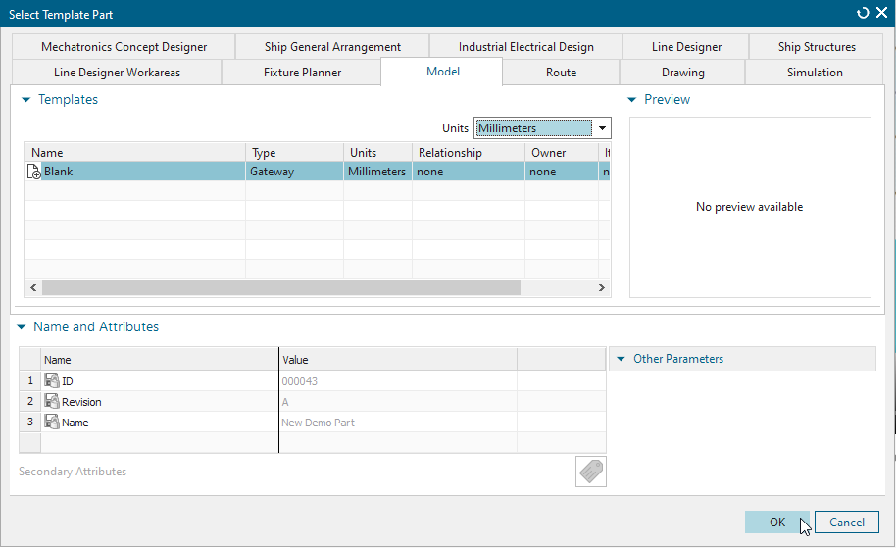
New Part
When part is opened, NX asks for modeling environment
Select Model and OK

Slide 27
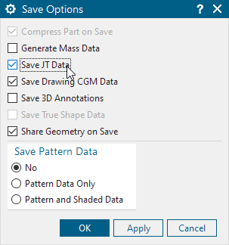
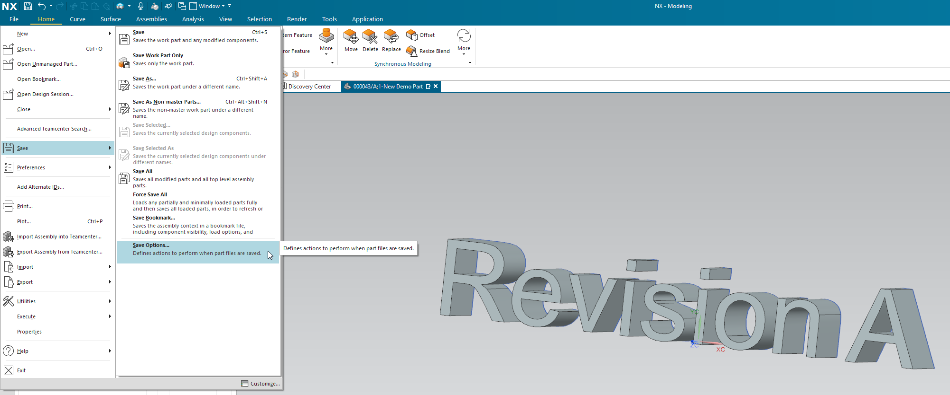
New Part
Create part geometry
Select Application and Modeling
Under Save, select Save Options and check Save JT Data
This allows preview in Teamcenter
Save the file

Slide 28
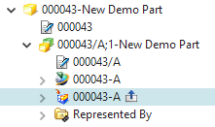
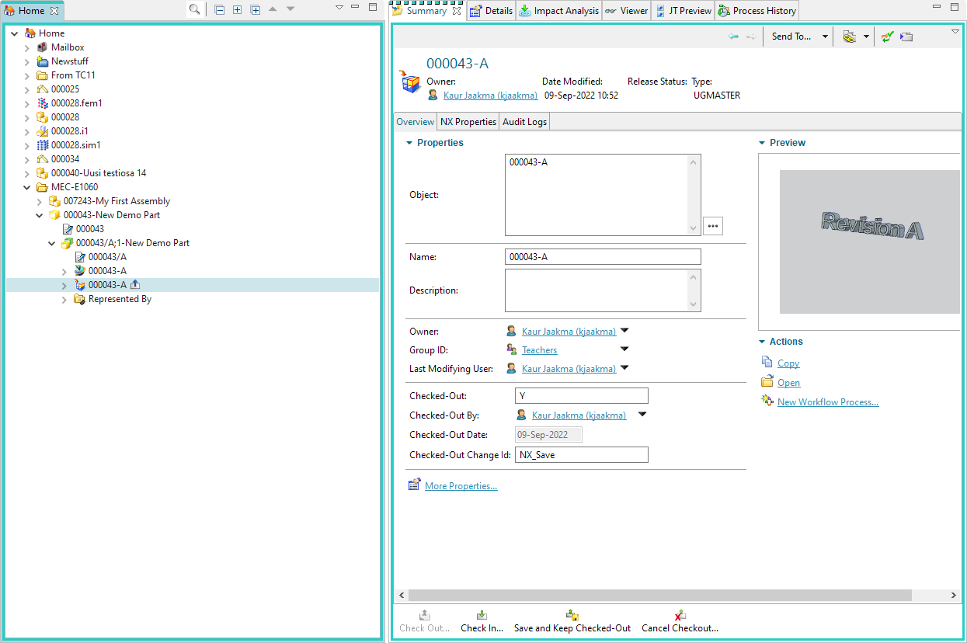
New Part
Leave NX open and go to Teamcenter
Notice the updated part
Part geometry is still open
Close the model in NX with X
Geometry will be checked in

Slide 29
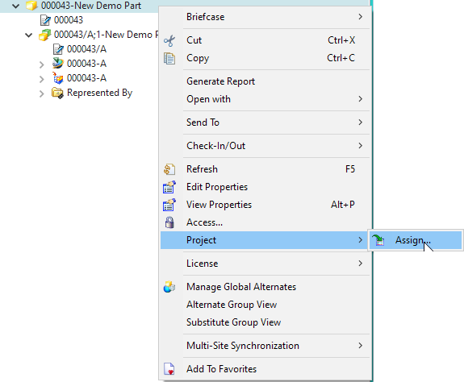
Assign Part to a Project
To enable sharing of the model, the item must belong to a project
2022-Group-##
## in your group number
By default, Student’s model is only visible to student itself and to Teachers

Slide 30
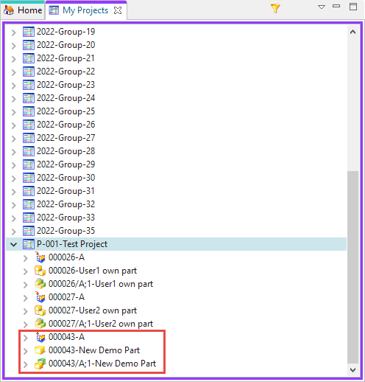
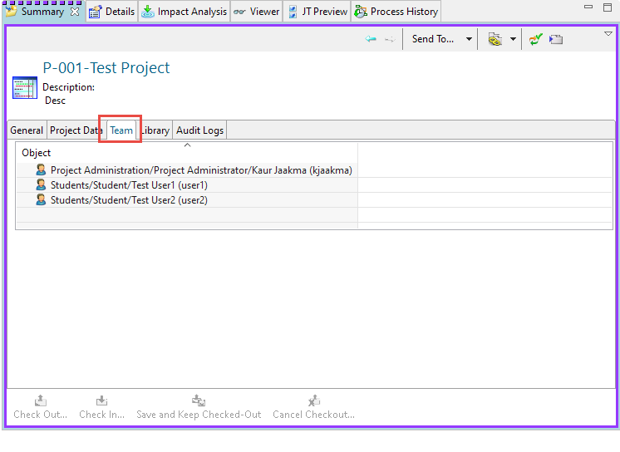
My Projects
Available in Quick links
Left side of user interference
Here you can see all projects you have view/edit rights
Items stored under project are accessible by project members
Remember to share Items

Slide 31
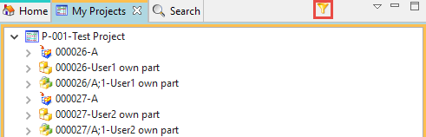
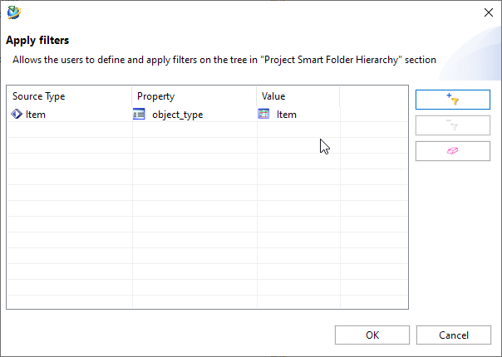
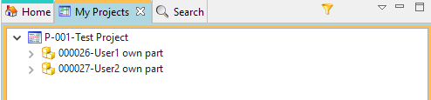
Filters

Slide 32
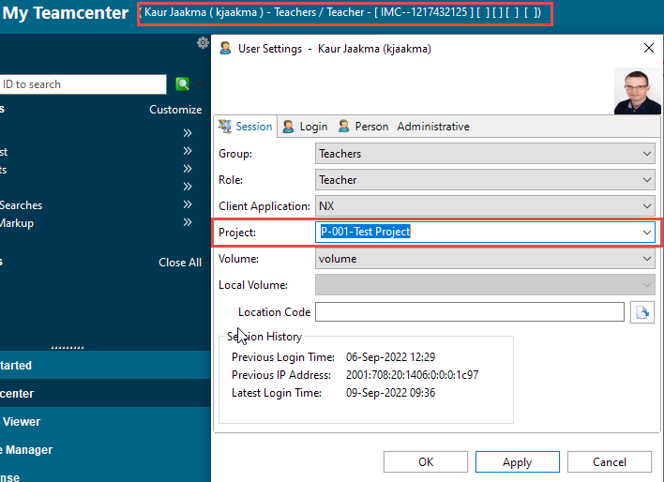
Working in Project
From the user profile you can see your role and project
If a project is selected, new items will be stored to that project by default

Slide 33
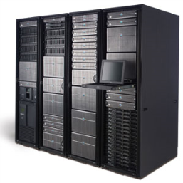
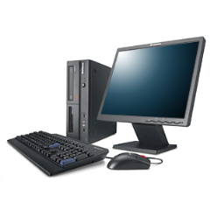
Check In/Out Procedure
Check-in
Process to systematically lock an item for modifying by user
Prevents others to modify item
If another user opens item, sees only the version in the server
Good practice to give comment when checking out
Creates log
A;3
A;2
A;3*
A;2
Check-out

Slide 34
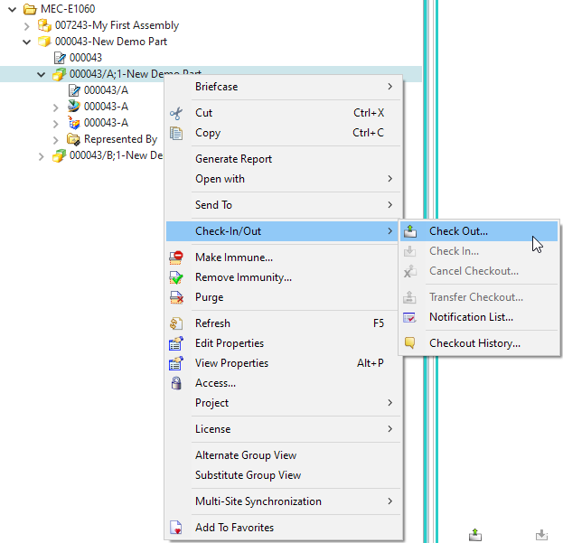
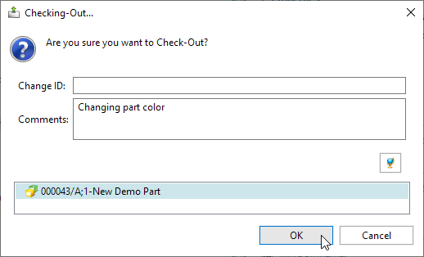
Check In/Out Procedure
Select Revision

Slide 35
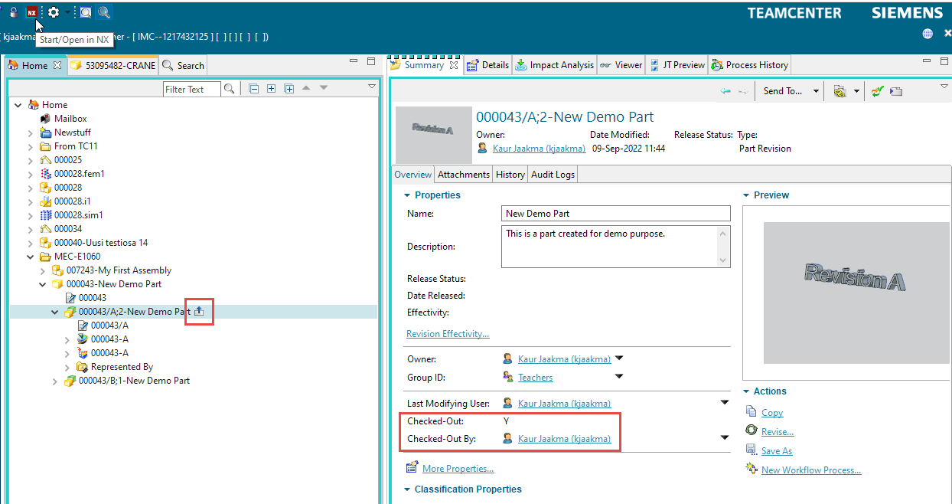
Check In/Out Procedure
Notice the symbol
And Fields

Slide 36
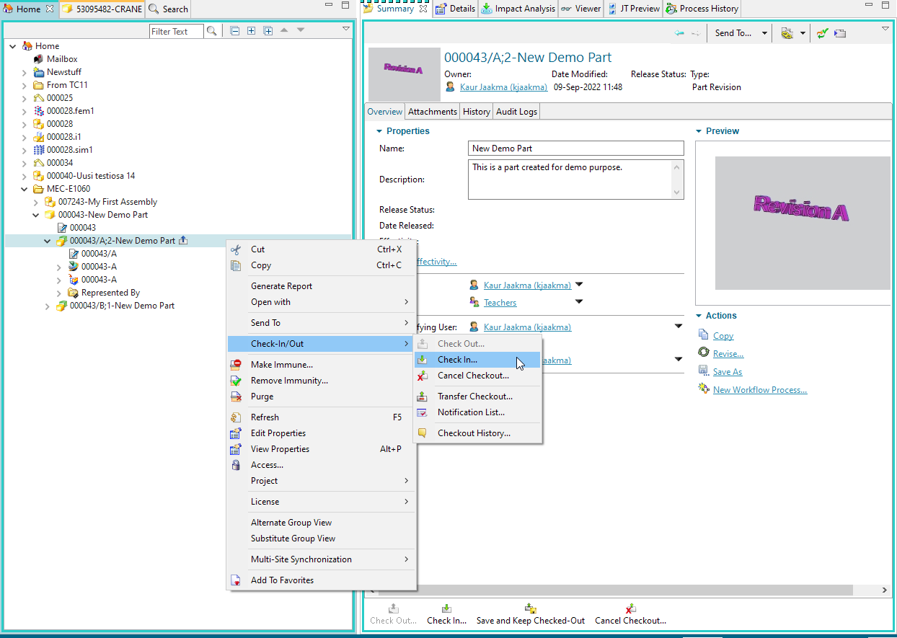
Check In/Out Procedure
When model is updated, Check In
Notice the possibility to cancel Checkout and cancel changes

Slide 37
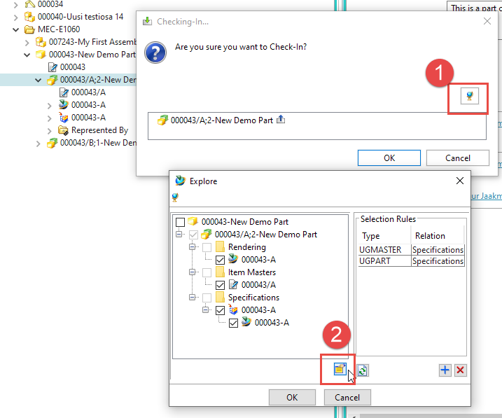
Check In/Out Procedure
Remember to include all children of the checked out item
In this case CAD geometry

Slide 38
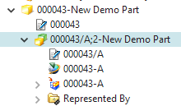
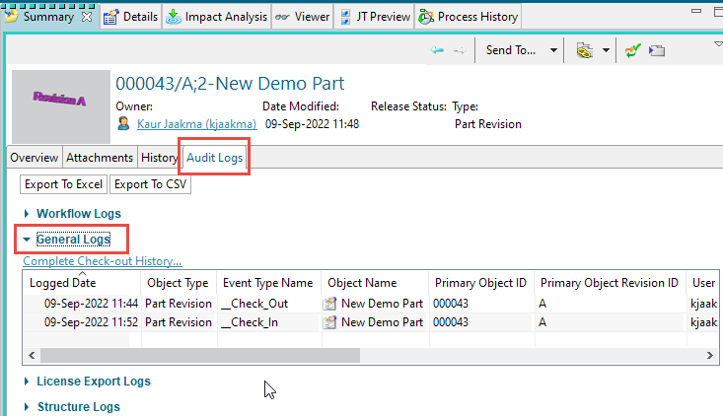
Check In/Out Procedure
New Sequence of a Revision A is created
A;2
Older sequence (A;1) is hidden by default
Logs are also created

Slide 39
Creating Revisions
Two ways to create
Thru Teamcenter
If Revision selected
Thru NX
If connected to Teamcenter

Slide 40
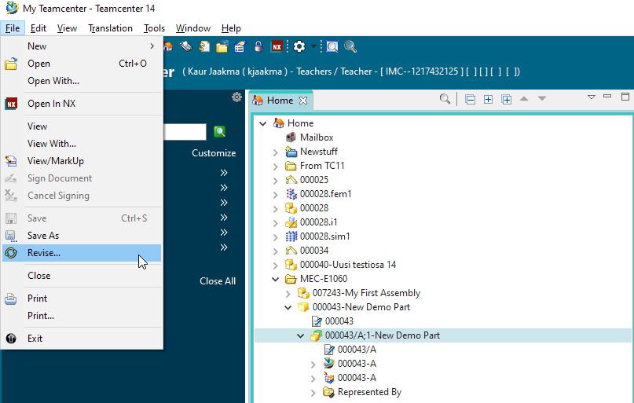
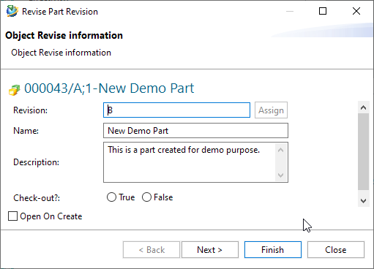
Creating Revisions
In Teamcenter

Slide 41
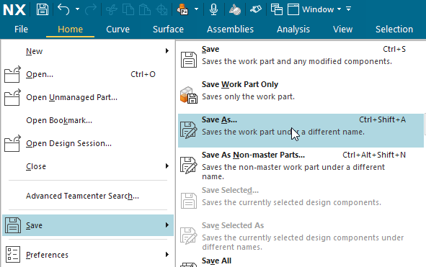
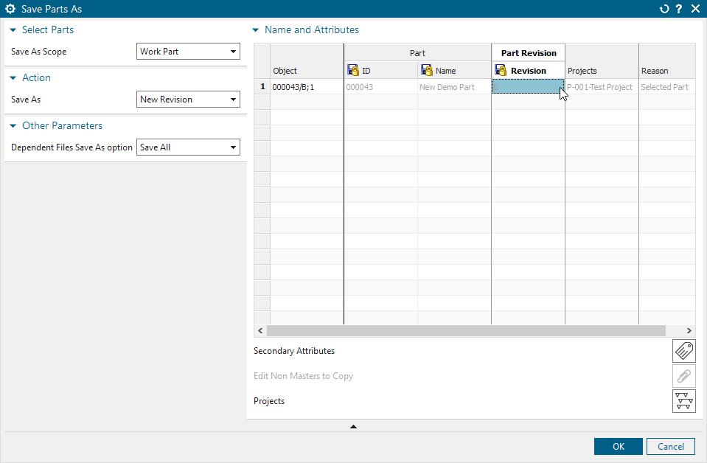
Creating Revisions
In NX

Slide 42
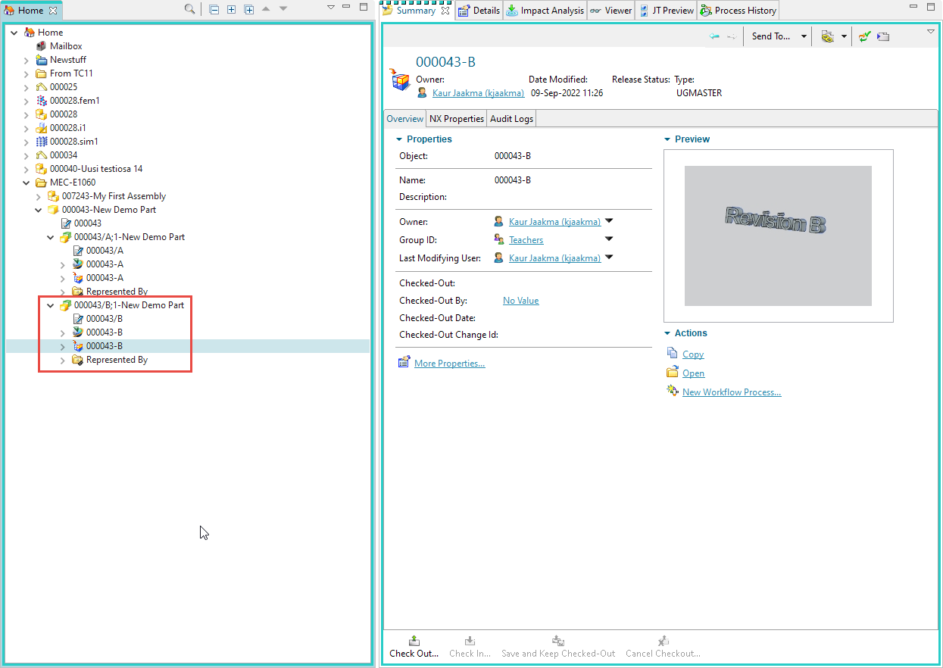
New Revision in Teamcenter
Revision B

Slide 43

Creating Revisions
In NX and Assembly selected
Select all parts and issue new revision
Remember double-click

Slide 44

Search
Searches Items
Default is using Item ID
Can be changed to Item Name
Wildcard * is very useful
Item name is a string

Slide 45

Search Item Name = Crane

Slide 46


Advance Search
Possibility to narrow down searched objects
For ex. owned by me

Slide 47

Importing Offline Parts into Teamcenter
NX open in Teamcenter Session
File → Import Assembly Into Teamcenter…
Define needed fields
Item Type
Select parts to be imported
Check information and update
Assign to Project (if needed)
Import

Slide 48

Importing Offline Parts into Teamcenter
If no errors in Information window, import was success
You can check your imported parts in Home folder

Slide 49
Active Workspace

Slide 50

Login
Browser version

Slide 51
Under Construction

